Slide 1
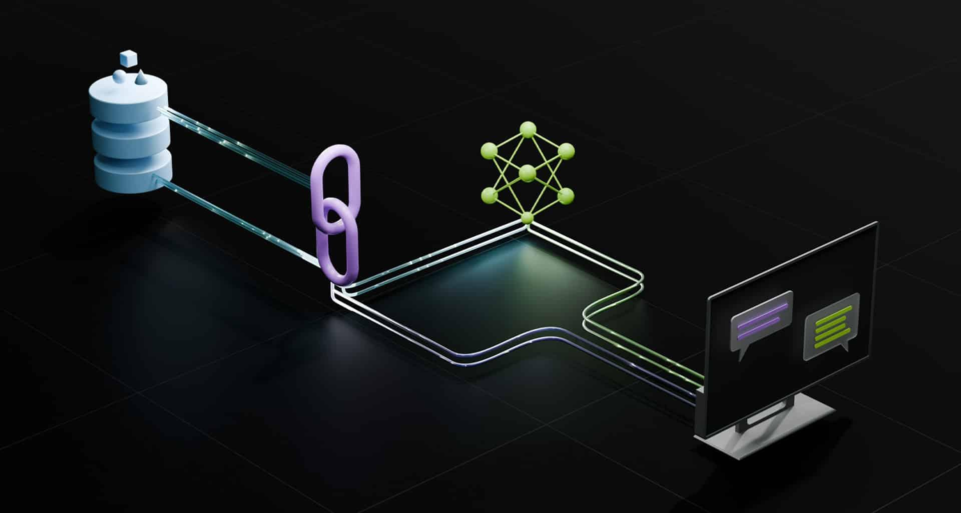
Session : 2
Retriever Augmented Generation (RAG)

Slide 2
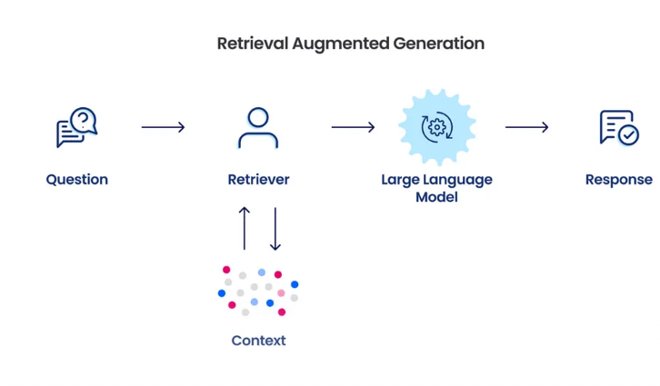
Introduction to RAG
Retrieval-Augmented Generation (RAG) is a framework that enhances LLMs by grounding their outputs in retrieved external knowledge. Instead of relying only on what the model memorized during training, RAG dynamically pulls in relevant context from a knowledge base, documents, or databases.
Key Benefits
Factuality & Accuracy – Reduces hallucinations by anchoring responses in verified sources.
Freshness – Enables LLMs to access updated knowledge beyond their training cutoff.
Domain Adaptability – Customizes outputs for enterprise or specialized datasets.
By bridging retrieval (information access) and generation (language fluency), RAG empowers AI systems to deliver more reliable and context-aware responses.

Slide 3
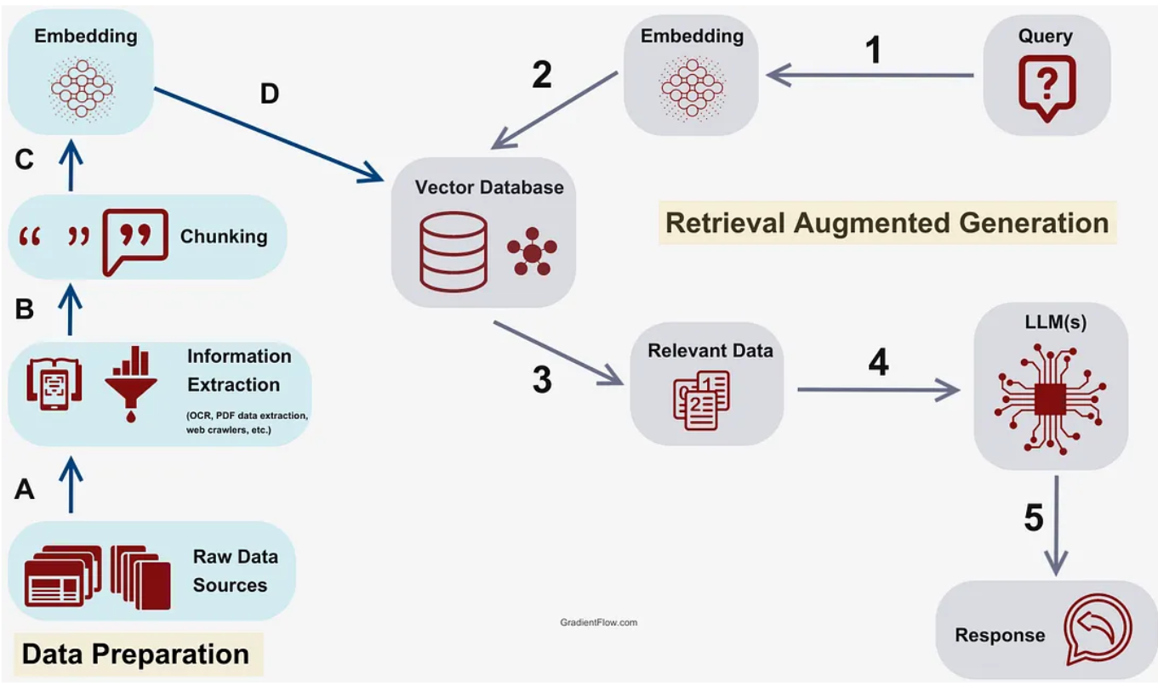
Working of RAG
RAG follows a retrieve → generate pipeline where the LLM is augmented with contextual knowledge.
Core Workflow
User Query – The input question or prompt initiates retrieval
Retriever – Uses embeddings + vector search to fetch top-k relevant documents from a knowledge base.
Generator – The LLM consumes both the user query and retrieved passages to construct a grounded response.
Response Delivery – The output is factually enriched, coherent, and contextually aligned.
Architecture Layers
Retriever → Dense passage retrieval, BM25, or hybrid search.
Generator → Pre-Trained LLM (GPT, LLaMA, etc.) fine-tuned for reasoning.
Knowledge Base → Documents, SQL databases, APIs, or enterprise data lakes.
This fusion of information retrieval with generative reasoning is what makes RAG robust for real-world applications.

Slide 4
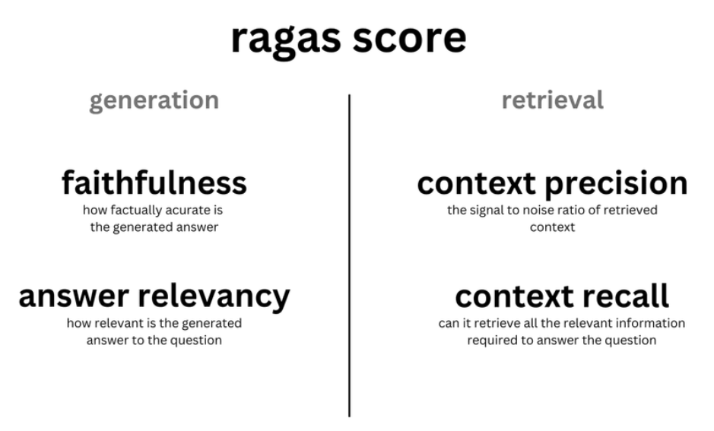
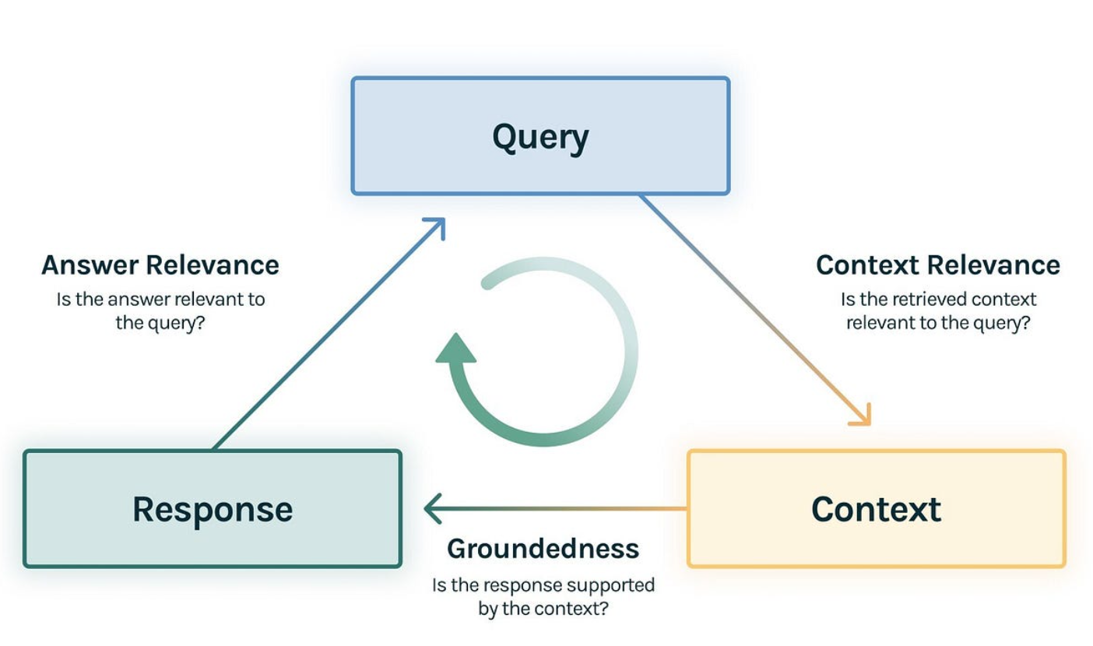
RAG Evaluation
Evaluating RAG requires analyzing both retrieval quality and generation faithfulness.
Key Dimensions
Relevance – Do the retrieved documents contain the needed information?
Faithfulness – Is the generated response consistent with retrieved sources?
Completeness & Coherence – Does the answer fully and clearly address the query?
Evaluation Techniques
Retrieval Metrics – Recall@k, Precision@k, MRR (Mean Reciprocal Rank).
Generation Metrics – BLEU, ROUGE, METEOR for text overlap.
Faithfulness Scores – Checking alignment of answers with retrieved docs.
Human-in-the-Loop – Expert review to ensure accuracy and trustworthiness.

Slide 5
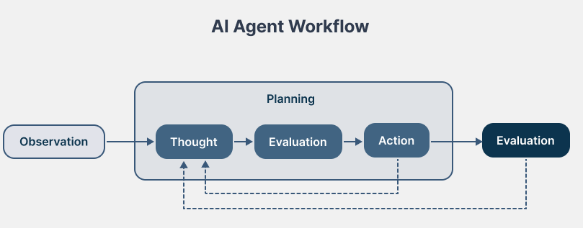
What is Agentic AI ?
Agentic AI represents the evolution of LLMs into autonomous, goal-driven agents. Unlike passive chatbots, these systems can perceive, reason, plan, and act across complex workflows.
Core Principles
Perception – Understands user goals, context, and environment.
Reasoning – Decomposes tasks, performs logical steps, and decides actions.
Action – Executes steps using tools, APIs, or system commands.
Reflection – Monitors outcomes, corrects errors, and adapts strategies.
Applications
Enterprise AI Assistants – Automating business intelligence, research, or reporting.
Autonomous Research Agents – Running multi-source investigations.
Workflow Automation – Coordinating with APIs, CRMs, and knowledge systems.

Slide 6
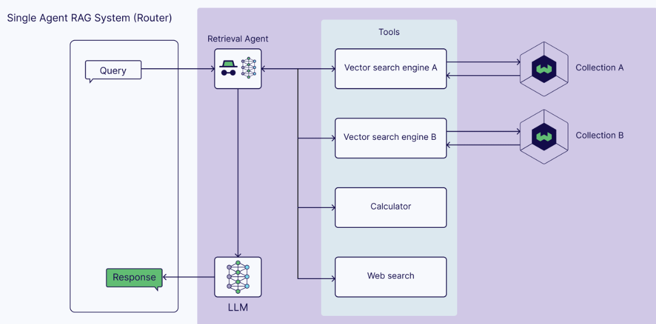
Agentic RAG
Agentic RAG extends traditional RAG by giving the LLM agent-like autonomy to refine, adapt, and act. Instead of a single static retrieval, the model can perform multi-step reasoning and dynamic tool use.
Key Capabilities
Query Reformulation – If results are weak, the agent can rephrase queries for better retrieval.
Iterative Reasoning – Uses multiple retrieval + generation loops to refine answers.
Tool Integration – Calls APIs, databases, or calculators in addition to retrieving documents.
Adaptive Workflows – Chooses when to retrieve, when to generate, and when to escalate.
Agentic RAG creates self-improving retrieval loops where the system acts like a researcher — searching, verifying, and synthesizing before responding. This shifts RAG from static Q&A to autonomous knowledge agents.

Slide 7

Introduction to LangGraph
(Agentic AI FrameWork)

Slide 8
Why LangGraph?
01

Slide 9
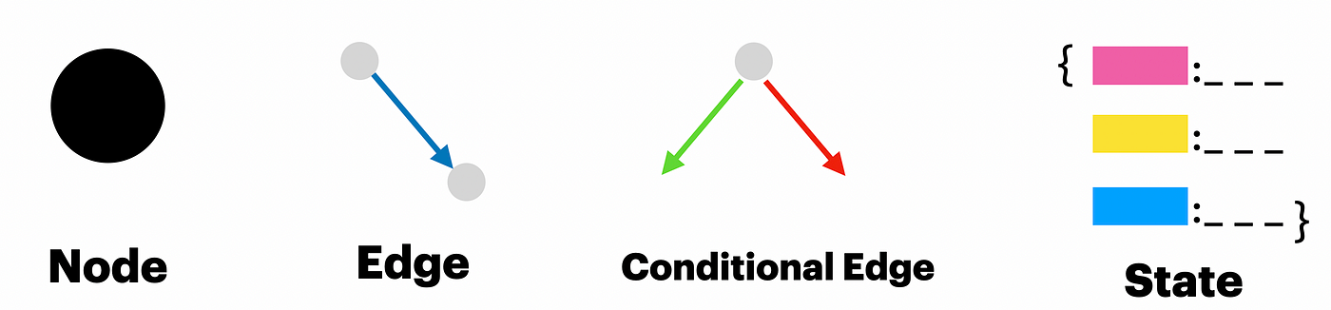
Why LangGraph ?
LangGraph is designed for developers who aim to build powerful, reliable, and flexible AI agents. It offers a structured way to go beyond simple chains and build multi-agent, stateful, and controllable applications.
Reliability & Controllability
Guide agent behavior with moderation checks and human-in-the-loop approvals. Maintain persistent context to support long-running workflows.
Built with low-level primitives, LangGraph allows fully customized agent workflows. Ideal for scalable multi-agent systems, where each node plays a well-defined role.
Core Elements - LangGraph uses cyclical graphs with:
Nodes – LLMs, tools, or agents that represent computation units. The special END node marks completion.
Edges – Define execution paths; can be basic (sequential) or conditional, based on logic.
State – A shared memory layer accessible by all components. It:
Stores intermediate results
Enables pause/resume workflows
Supports complex behaviors like error correction and human escalation

Slide 10
Core Concepts - LangGraph
02

Slide 11
Core Concepts in LangGraph
Component | Description (Short & Crisp) | How It Helps / Differentiates from Standard RAG
StateGraph | Defines the structure of the agent workflow using nodes and transitions. | Enables modular, multi-step reasoning instead of single-turn retrieval & response.
Nodes | Atomic units performing specific tasks like tool execution or agent invocation. | Promotes separation of concerns and easy integration of diverse tools/LLM capabilities.
Edges | Define dynamic flow between nodes based on conditions or outputs. | Introduces control flow logic, allowing decisions and branching—absent in linear RAG systems.
State Management | Maintains and updates a persistent state passed between nodes. | Allows memory retention and contextual evolution across multiple steps—enabling advanced reasoning.
START / END | Entry (START) and exit (END) markers that structure graph execution. | Makes the workflow explicit, ensuring deterministic flow and traceability—unlike loosely connected RAG steps.

Slide 12
Nodes & Tool Calling
03

Slide 13
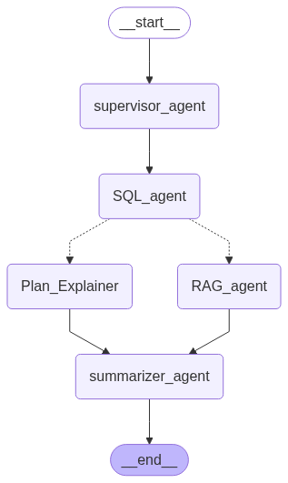
Router Node : Directs the flow of execution based on the current state or user query.
Functionality (Short & Crisp):
Acts like a traffic controller.
Uses logic (e.g., keyword match, classification, scoring) to decide the next node to route the request to.
Enables dynamic decision-making in the workflow.
Why it matters: It brings conditional branching to your pipeline—critical for handling varied queries in a single agentic system (vs. static, one-size-fits-all logic in basic RAG). Supervisor Node : Monitors and coordinates the actions of other nodes, optionally modifying the flow or state.
Functionality (Short & Crisp):
Think of it as a central controller or "manager" node.
Evaluates results from child nodes and decides what to do next (retry, reroute, summarize, etc.).
Can oversee multi-agent orchestration.
Why it matters: It adds a layer of reasoning and quality control—like having a human-in-the-loop supervisor for AI agents. This enhances adaptability and reliability, especially in complex multi-step tasks.
Router Node

Slide 14
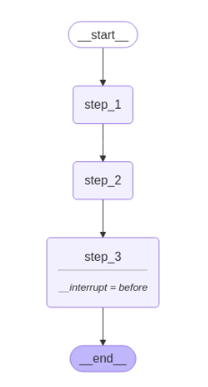
Human - in - the - Loop
LangGraph enables human intervention at any point in the workflow — ideal for use cases where LLM outputs require review, correction, or contextual input.
Key Capabilities:
Persistent Execution State LangGraph checkpoints the graph after each step, enabling pause and resume anytime, even asynchronously. Supports long-running workflows with human review.
Flexible Interrupt Options
Dynamic Interrupts – Triggered from inside a node based on current state
Static Interrupts – Predefined before or after node execution
Seamless Integration
Insert human logic at any step of the graph
Perfect for approvals, content validation, or manual corrections

Slide 15
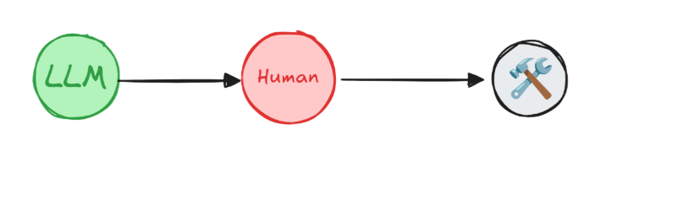
Human - in - the - Loop (Pattern)
Common Patterns Using interrupt & Command:
Approve or Reject
Pause before critical steps (e.g., API/tool calls) to approve or block execution based on human input.
Edit Graph State
Pause to modify the state (e.g., fix wrong assumptions, add new info) before proceeding.
Review Tool Calls
Review/edit tool requests before they execute, ensuring accuracy and safety.
Validate Human Input
Pause to confirm correctness of user-provided data before using it in downstream logic.

Slide 16
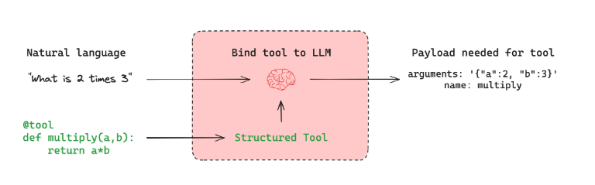
Tool Calling
In many AI workflows, agents must interact with external systems like APIs, databases, or file systems. Tool calling enables language models to structure requests that can be passed to such systems going beyond simple conversation.
How Tool Calling Works
Tools wrap a function and input schema
Based on user input, the model may return a tool call via tool_calls
llm_with_tools.invoke("What is 2 multiplied by 3?")
# -> AIMessage(tool_calls=[{'name': 'multiply', 'args': {'a': 2, 'b': 3}}])
If no relevant tool is needed, model responds naturally: llm_with_tools.invoke("Hello world!")
# -> AIMessage(content="Hello!")
Types of Tools Prebuilt Tools – Ready integrations for:
Web Search: Bing, Tavily, SerpAPI || Code Execution: Python REPL || Databases: SQL, Redis, MongoDB || API’s: OpenWeatherMap, NewsAPI

Slide 17
Understanding Memory in Ai Agents
04

Slide 18
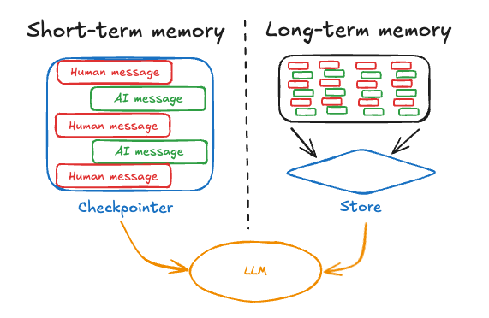
Why Memory Matters?
Enables AI agents to remember, adapt, and learn over time.
Crucial for handling multi-step tasks, personalization, and contextual continuity.
Short-Term Memory
Powered by LangGraph state/checkpoints.
Tracks files, retrieved docs, past outputs.
Challenge: long threads may overflow context → prune/summarize to manage.
Long-Term Memory
Persisted via LangGraph Stores (namespaces).
Type | Scope | Purpose
Short-Term | Session-specific | Track active thread or conversation
Long-Term | Persistent | Store facts, actions, user preferences

Slide 19
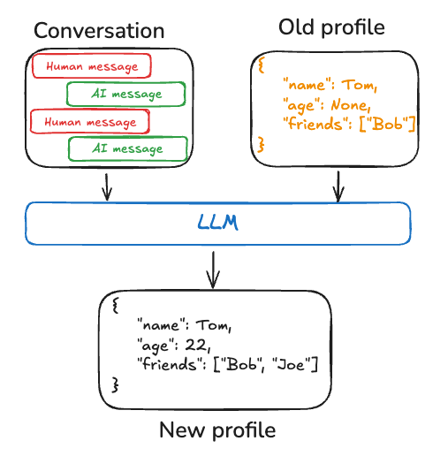
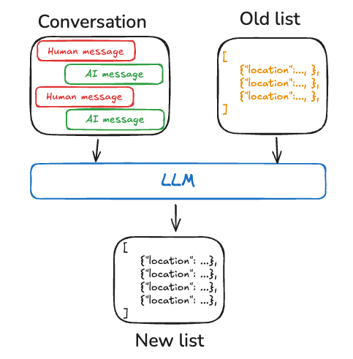
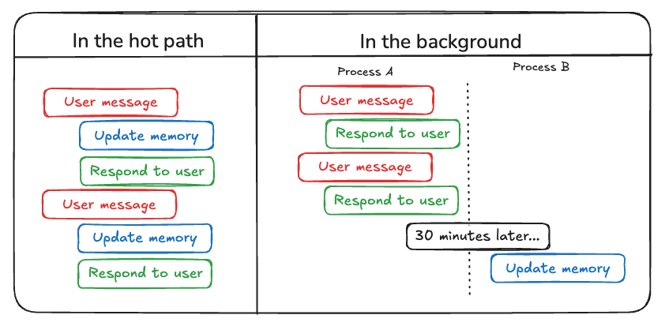
Key Design Principles
Use short-term memory for task continuity.
Use long-term memory for cross-session learning.
Memory Type | Storage / Best Practices
Semantic | Structured user profiles (JSON) / searchable docs
Episodic | LangSmith datasets with labeled past interactions
Procedural | System prompts, fine-tuned models, meta-prompts
Best Practices
Regularly summarize/prune short-term history.
Separate memory by namespace (e.g., per user/thread).
Ensure searchability and relevance in long-term storage.
Treat memory as a core design element, not an add-on.

Slide 20
Additional Resources for learning
05

Slide 21
Resources to Learn More
LangGraph Docs
Official Documentation Link
Official Tutorials
GitHub Examples
LangChain Discord / Community
Advanced repos with use cases

Slide 22
Thank You

